Slide 1

HSRP HIGH AVAILABLITY NETWORK PROJECT
Course:
Computer Networks Lab
Submitted To:
Sir Muhammad Fahad Irshad
Submitted By: (Group 6)
Sumaiya Bibi F2024266340
Rameen Junaid F2024266341
Tayyba Shahzad F2024266348
Eshmal Zahid F2024266755
Project Presentation

Slide 2
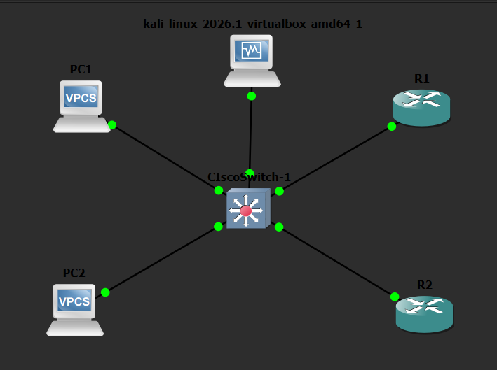
PROJECT INTODUCTION:
This project implements a High Availability Network using HSRP (Hot Standby Router Protocol).
Purpose:
The purpose of the project is to ensure continuous network connectivity and gateway redundancy in case of router failure.

Slide 3

PROJECT OBJECTIVES:
Implement HSRP for gateway redundancy.
Configure SSH for secure remote access.
Implement ACL-based security controls.
Perform failover and recovery testing.
Verify network connectivity and performance.

Slide 4
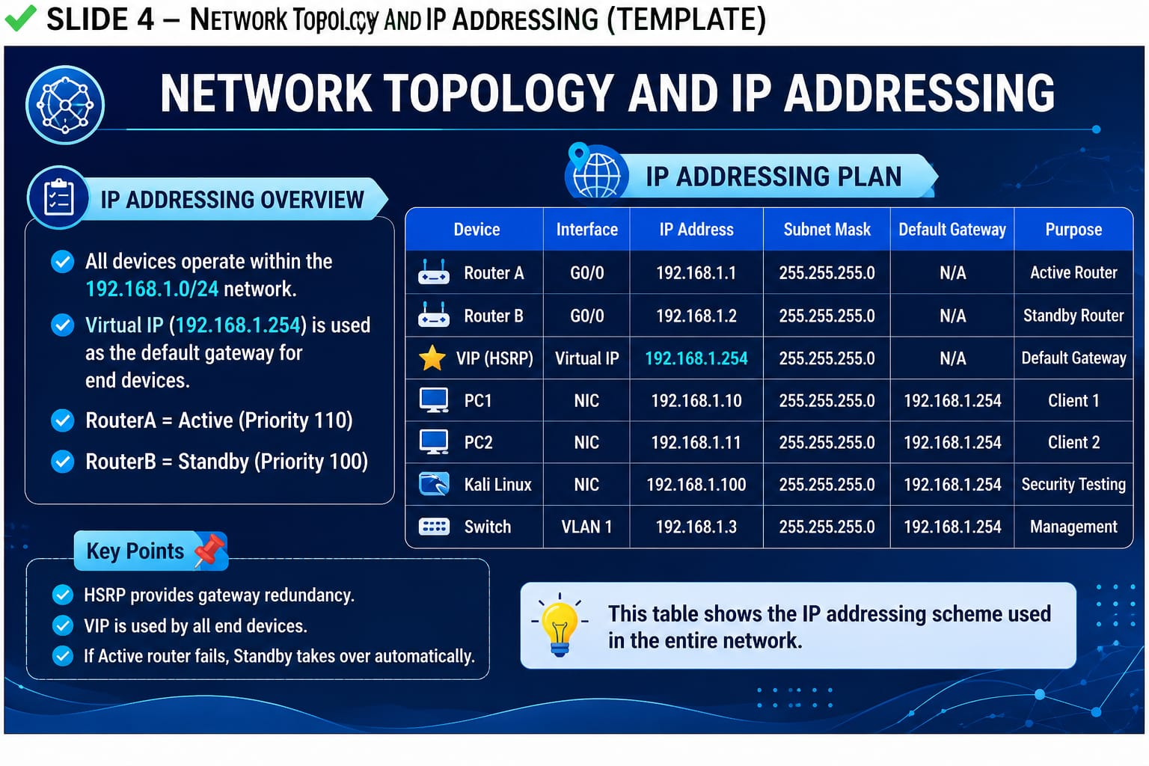

Slide 5
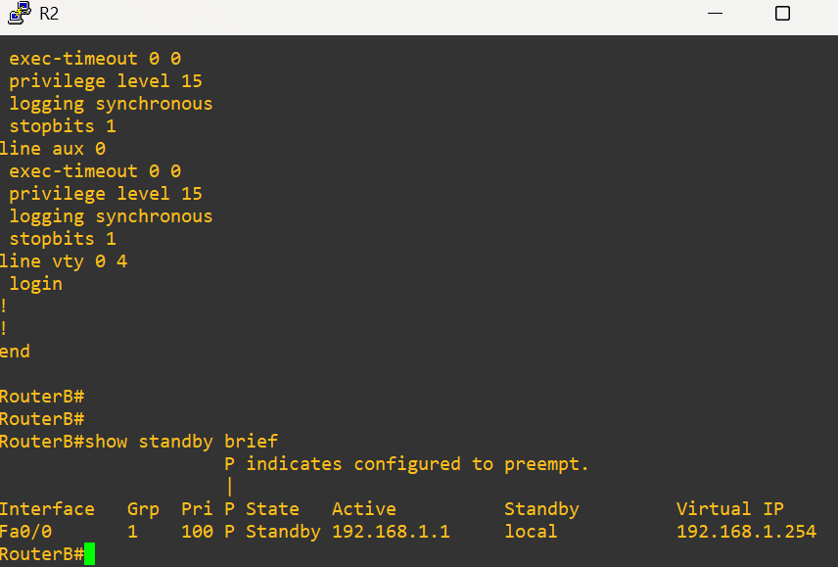
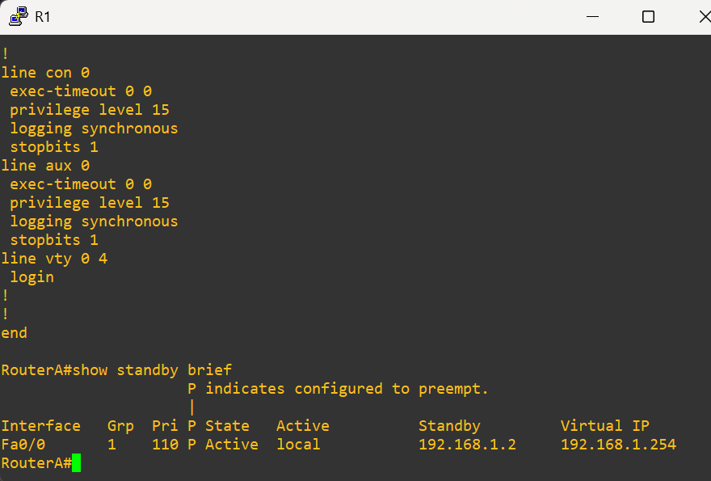
HSRP CONFIGURATION:
Router A was configured as Active Router.
Router B was configured as Standby Router.
Virtual IP Address: 192.168.1.254
HSRP provides automatic failover and gateway redundancy.
Router A HSRP Status:
Router B HSRP Status:

Slide 6

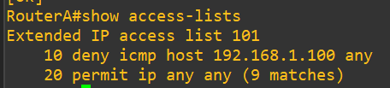
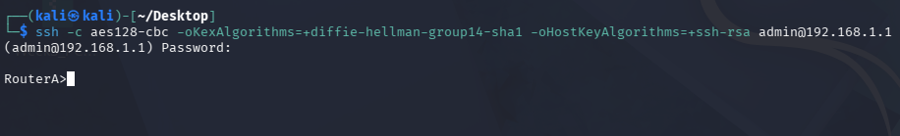
SECURITY IMPLEMENTATION:
Implemented Security:
SSH Configuration
ACL Configuration
ACL Verification:
These Security Measures Restrict Unauthorized Access and Protect The Network.
SSH Verification:

Slide 7
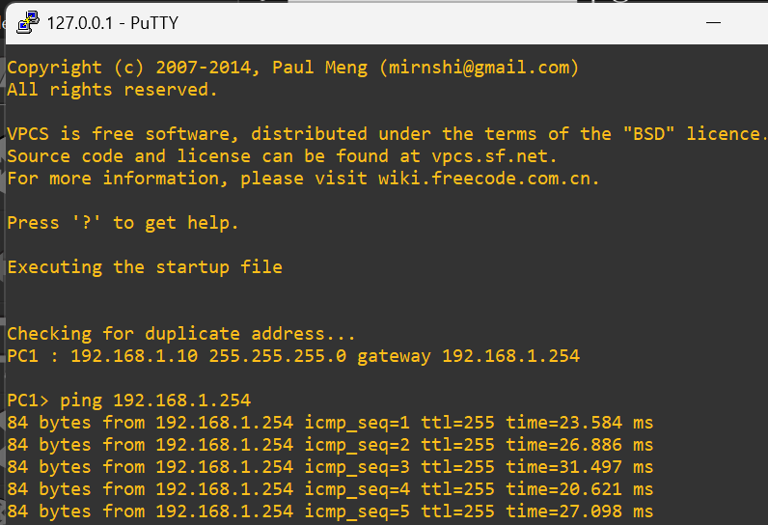
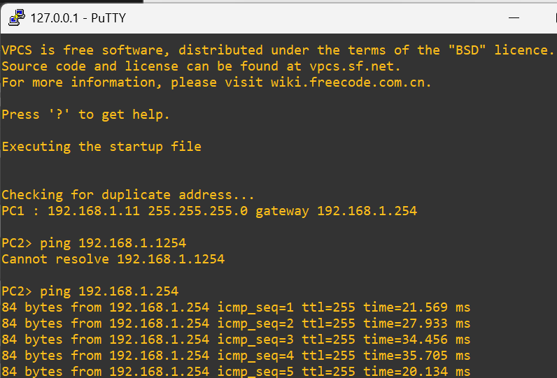
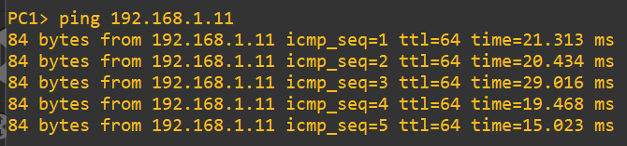
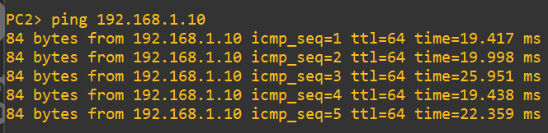
CONNECTIVITY TESTING:
Tests Performed:
PC1 > Virtual IP
PC2 > Virtual IP
PC1 > PC2
PC2 > PC1
All Connectivity Tests Passed Successfully.

Slide 8


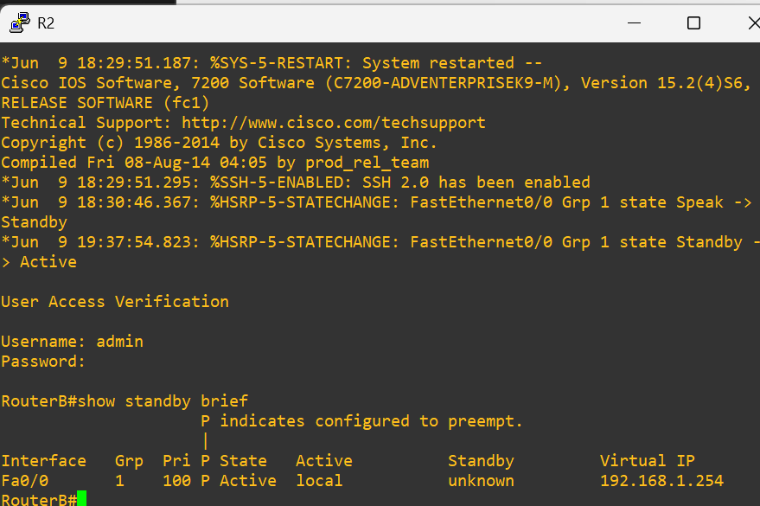
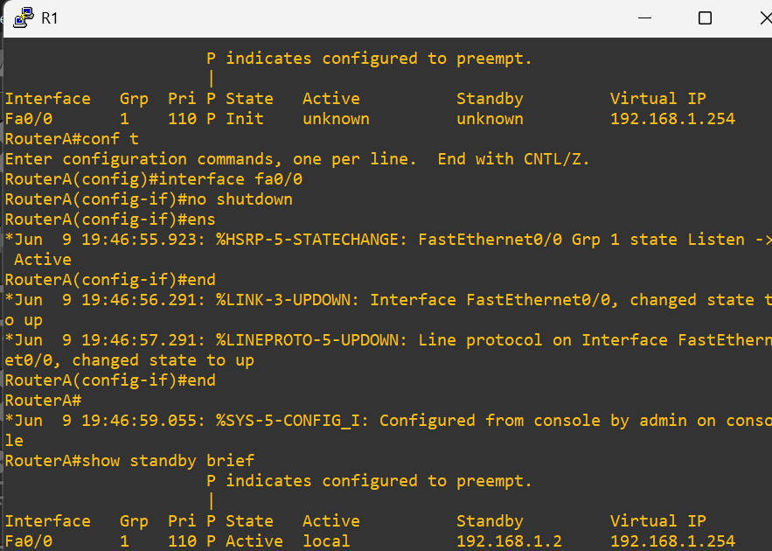
FAILOVER AND RECOVERY TESTING:
Failover Test:
Router A was Shutdown
Router B Automatically Became Active.
Recovery Test:
Router A was Restored.
Router A Resumed The Active Role.
After Failover (Router B Active):
After Recovery (Router A Active):

Slide 9
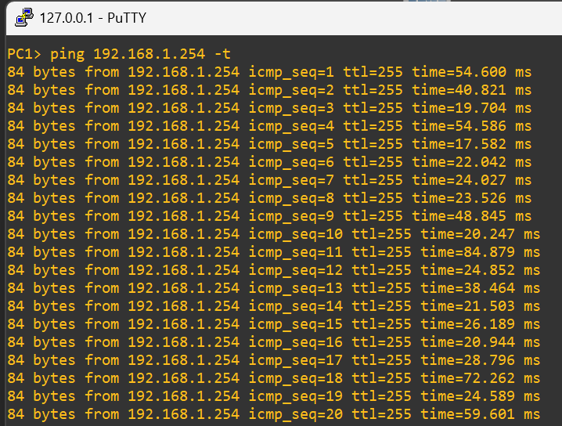
PERFORMANCE RESULTS:
Average Latency: Approximately 35 ms
Network Throughout Remained Stable During Testing.
Continuous ping test was performed on the HSRP Virtual IP (192.168.1.254).
No significant interruption was observed.
Results Summary:
Connectivity : PASS ACL : PASS
Failover : PASS SSH : PASS
Recovery : PASS Performance : PASS

Slide 10

Conclusion:
The HSRP-based high availability network was successfully implemented and tested.
Team Contributions:
Sumaiya: HSRP and Network Configuration
Rameen: ACL, SSH and Security Testing
Eshmal: Connectivity and Performance Testing
Tayyaba: Documentation and Presentation
THANK YOU!

